Slide 1
YOLO v1, v2, v3
You only look once
Tørres Lande

Slide 2
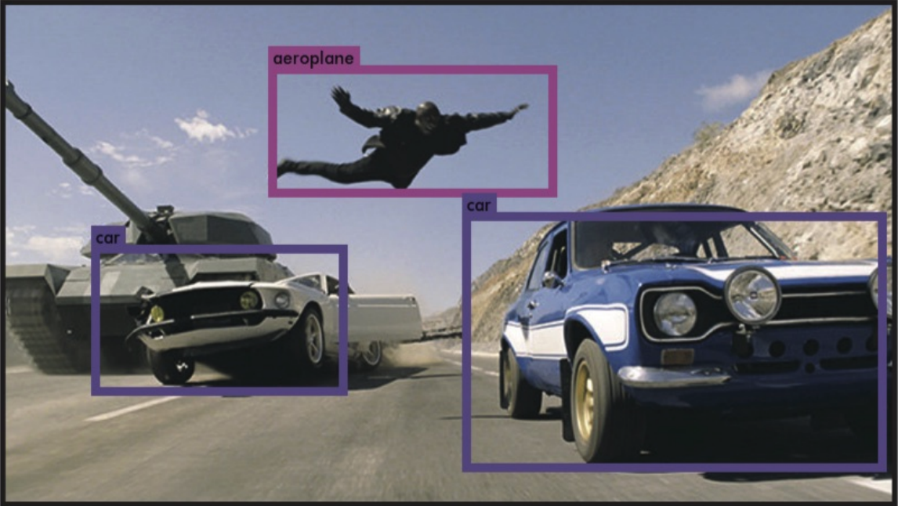
What is special about YOLO?
Fast yolo can run in 155 fps, mest video is 30 fps.
It have a global scope, so it can base it detection on context.
YOLO is good at generalizing images.
R-CNN have better accuracy.

Slide 3
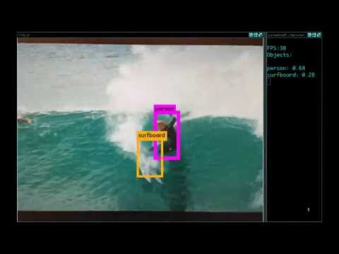

Slide 4
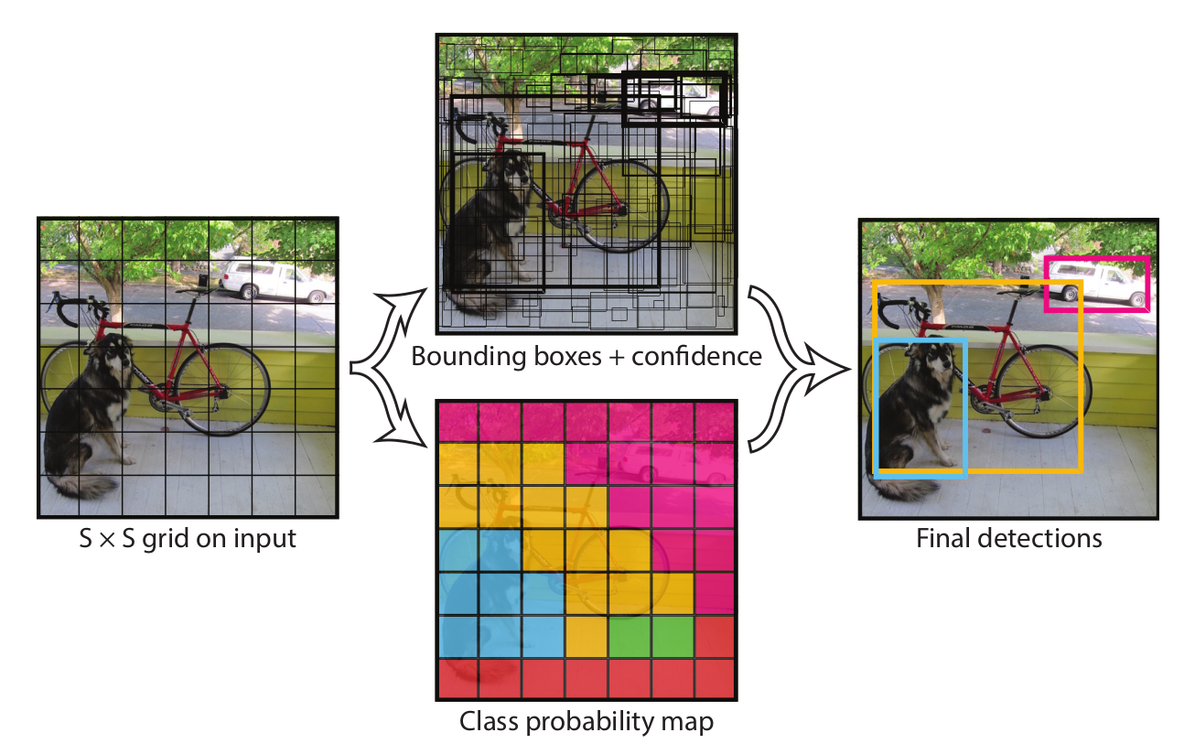
How does YOLO work?
Split the image into S x S grid
Each cell have 5 parameters
(x,y) = position
(h,w) = height, weight
c = confidence
Each cell predict two bounding boxes and a confidence score
predict conditional class probabilities p(Classi | Object)
Output = S x S (B x 5 + num classes)

Slide 5
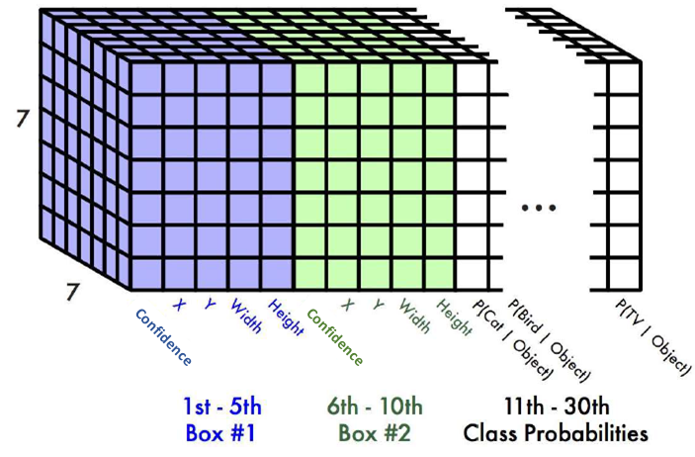
Output
(x,y) = position
(h,w) = height, weight
c = confidence
Pascal VOC
7 x 7 grid
2 bounding boxes
20 classes
7 x 7 x (2 x 5 + 20) = 7 x 7 x 30 tensor = 1470 outputs

Slide 6
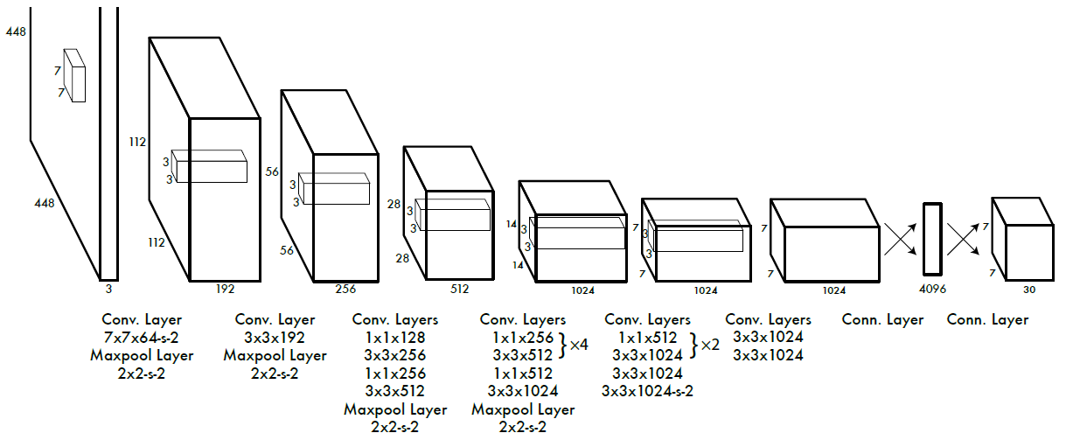
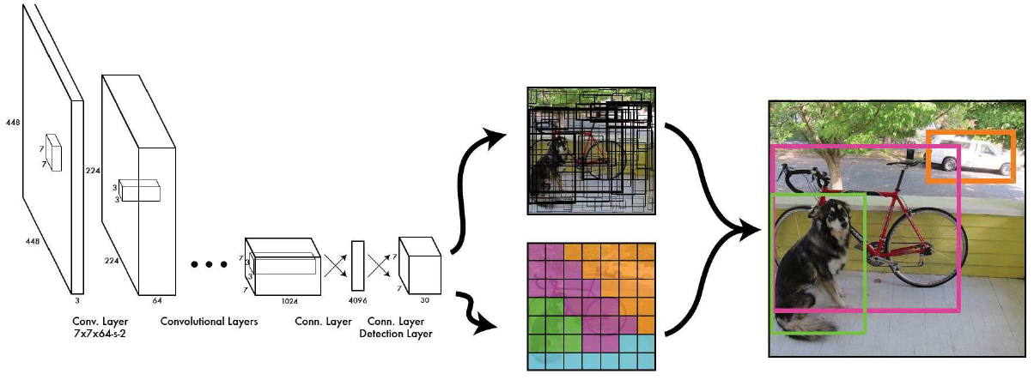
Model
Yolo
24 convolution layers
Fast Yolo
9 convolution layers
Both are inspired by googLeNet, that uses 1x1 convolution layer.

Slide 7
Training
Trained for one week
pre-trained on 224x224 for image classification, then 448x448 becuse image detection need more fine grained images.
Leaky ReLU

Slide 8
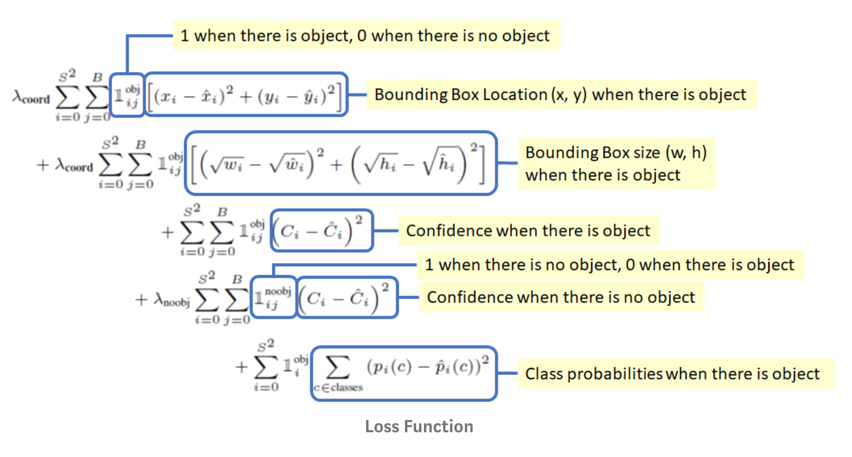
Loss function
location of the bounding boxes
(w, h) helps the loss function punishes small errors in big boxes less than i small boxes.
C = Confidence
p = probabilities
λ = weight

Slide 9
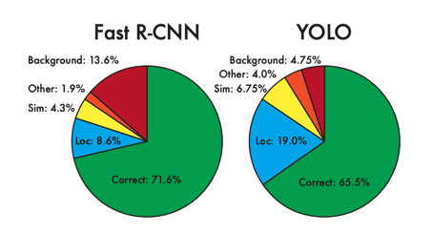
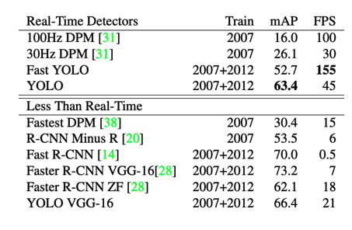
Comparison
YOLO v1 is faster then R-CNN but not more accurate
Yolo is more general, it outperform R-CNN on art work.
Can combine them to get higher accuracy, since they are good at different aspects.

Slide 10
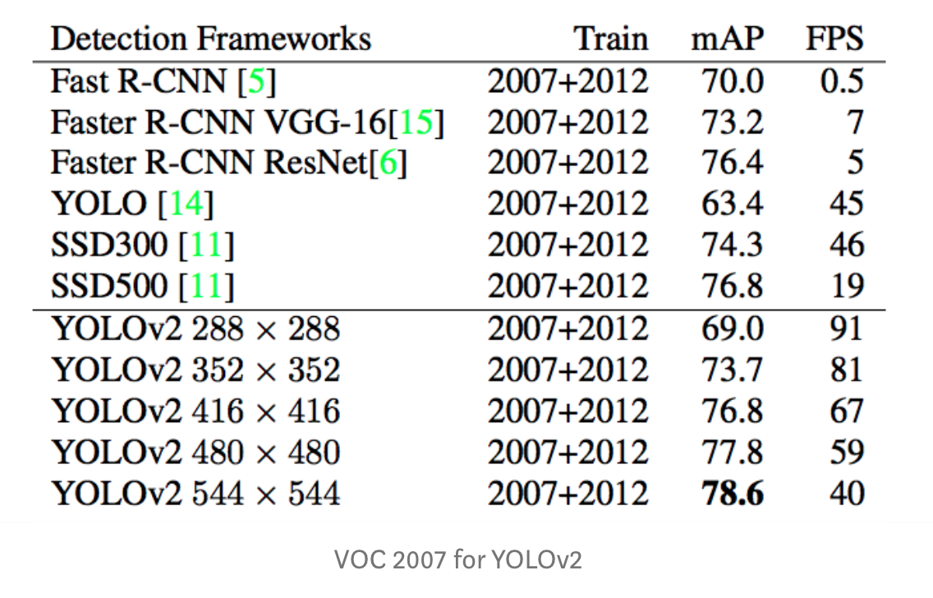
YOLO v2
YOLO used 448 x 448
YOLOv2 tested om multiple sizes
YOLOv2 480x480 > YOLO 448x448

Slide 11
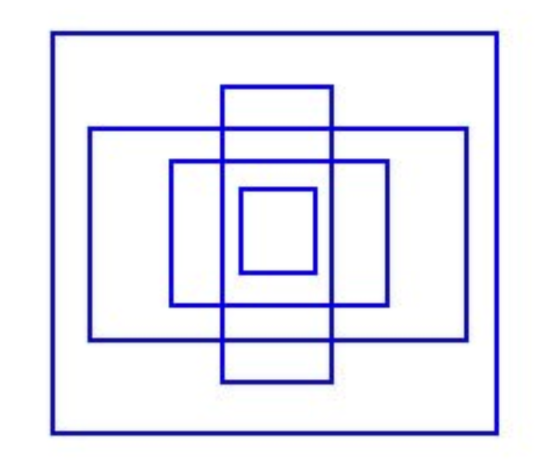
What did they do?
Batch normalization: mAP 2%
Train classifier with 224x224 and 448x448: mAP 4%
Anchor boxes: more stable training: mAP -0.3%, recall 7%
YOLO make arbitrary guesses on boundary boxes.
YOLOv2 create 5 anchor boxes, that focuses on shapes that most likely will fit a object
Dimentionsion cluster to find anchor points

Slide 12
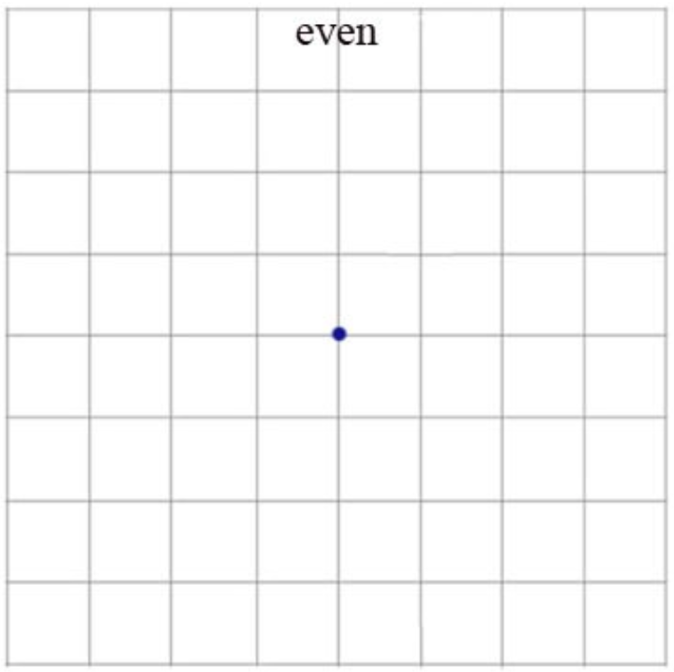
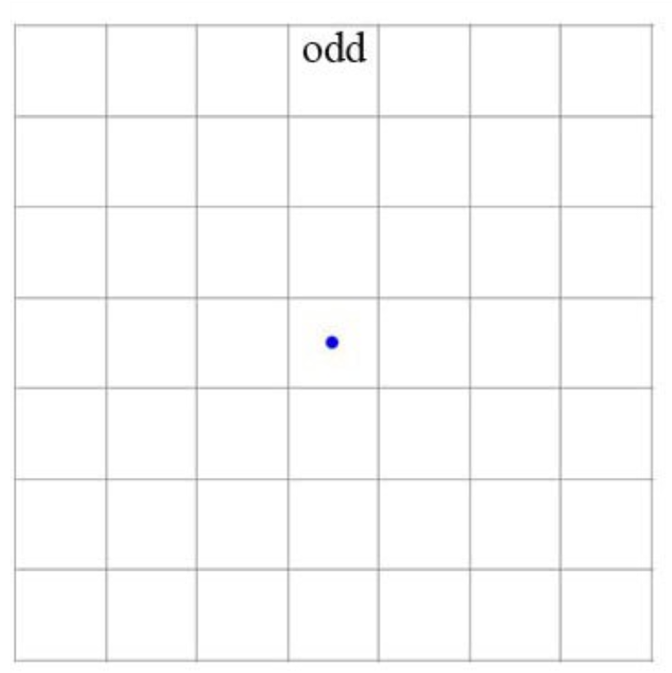
What did they do?
Odd number grid 448x448 -> 416x416: higher chance of detecting big images in the middle
Multiscale training
remove fully connected layer
can use multiple image sizes

Slide 13
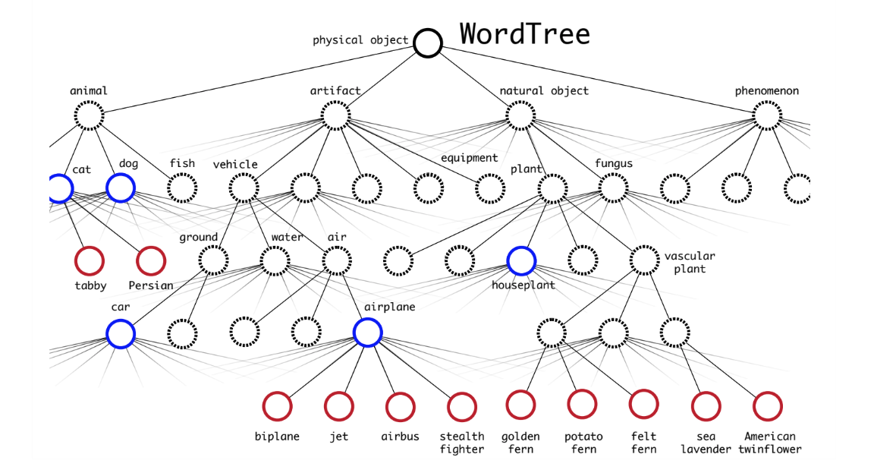
Classification

Slide 14
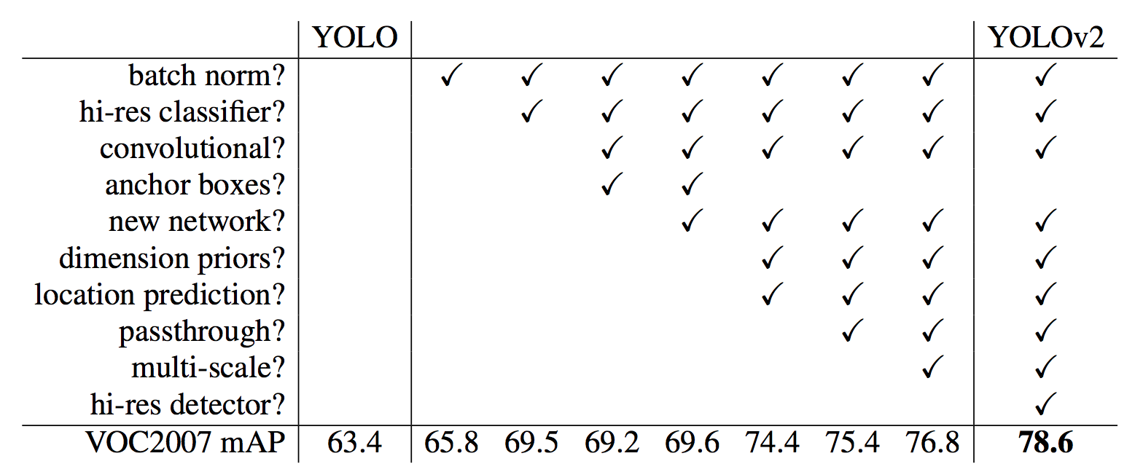

Slide 15
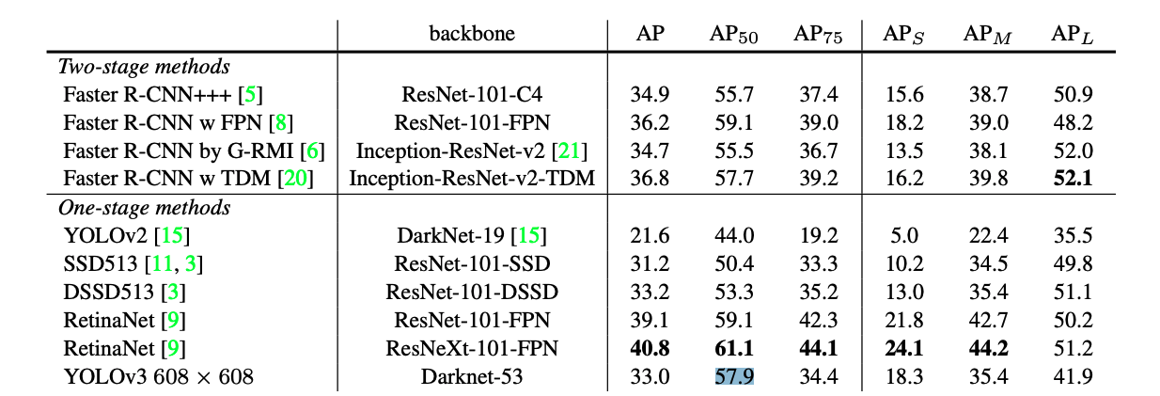
YOLO V3

Slide 16
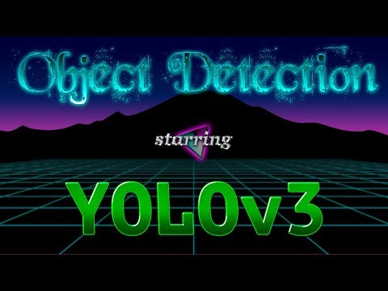

Slide 17
Sources
https://towardsdatascience.com/yolov1-you-only-look-once-object-detection-e1f3ffec8a89
https://www.youtube.com/watch?list=PLrrmP4uhN47Y-hWs7DVfCmLwUACRigYyT&v=NM6lrxy0bxs
https://arxiv.org/pdf/1506.02640.pdf
https://medium.com/adventures-with-deep-learning/yolo-v1-part-1-cfb47135f81f
https://medium.com/@divakar_239/yolo-v1-part-2-bfc686ae5560
https://medium.com/adventures-with-deep-learning/yolo-v1-part3-78f22bd97de4
https://hackernoon.com/understanding-yolo-f5a74bbc7967
https://pjreddie.com/media/files/papers/YOLOv3.pdf
https://medium.com/@jonathan_hui/real-time-object-detection-with-yolo-yolov2-28b1b93e2088

Slide 18
Questions?

